Slide 1
Click to progress through the presentation

Slide 2
Saint Ignatius College
Year 7 Information
Night 2021

Slide 3
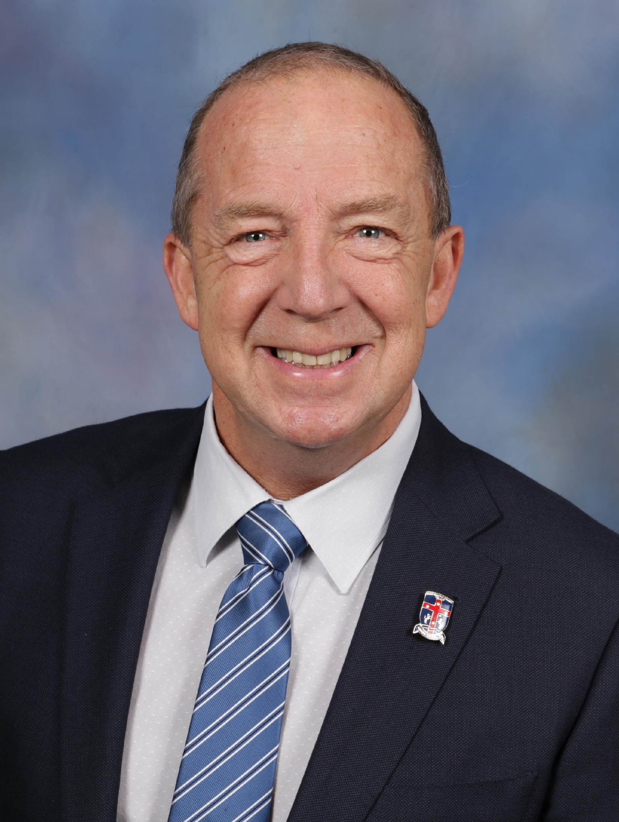
Saint Ignatius College
Welcome
Mr Paul Lewis Deputy Principal

Slide 4
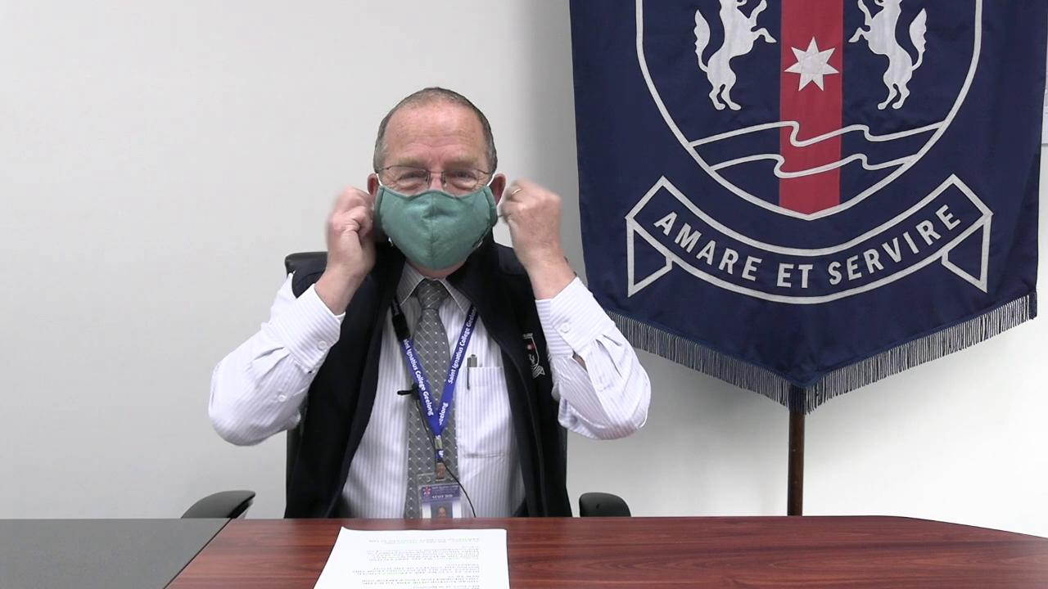

Slide 5
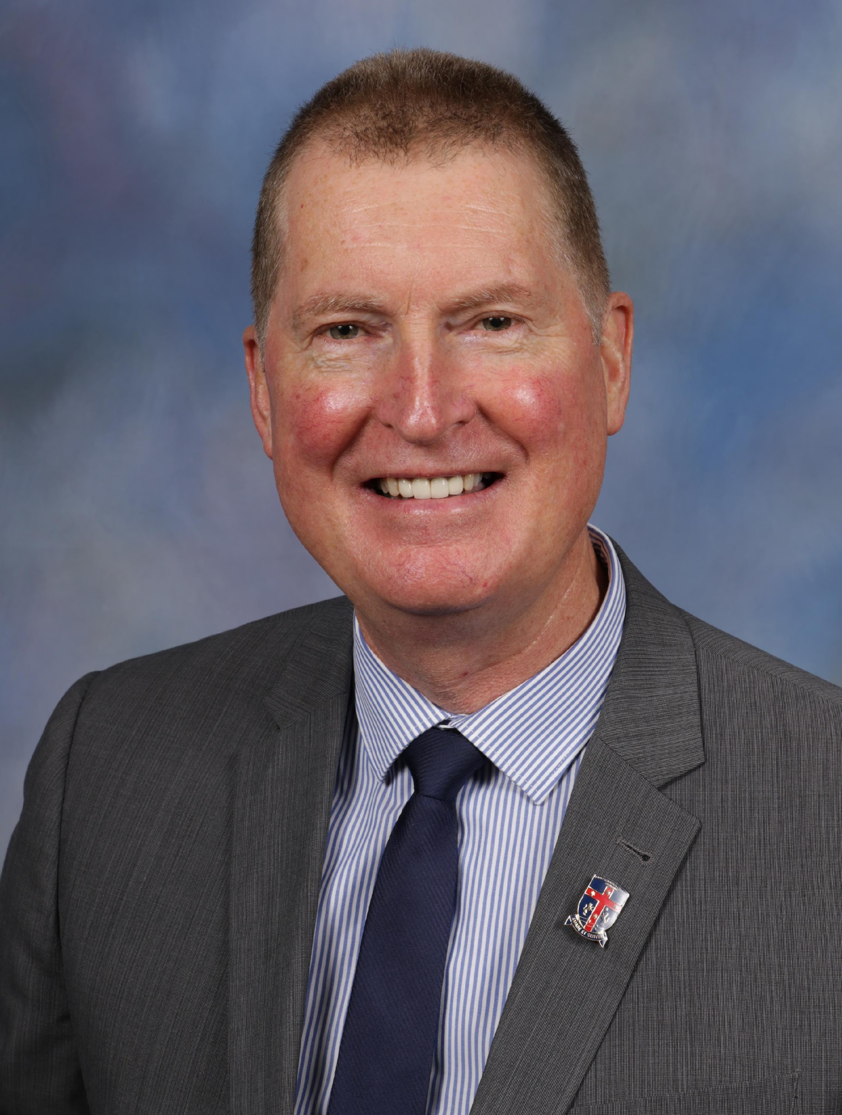
Saint Ignatius College
Principal’s Address
Mr Michael Exton Principal

Slide 7
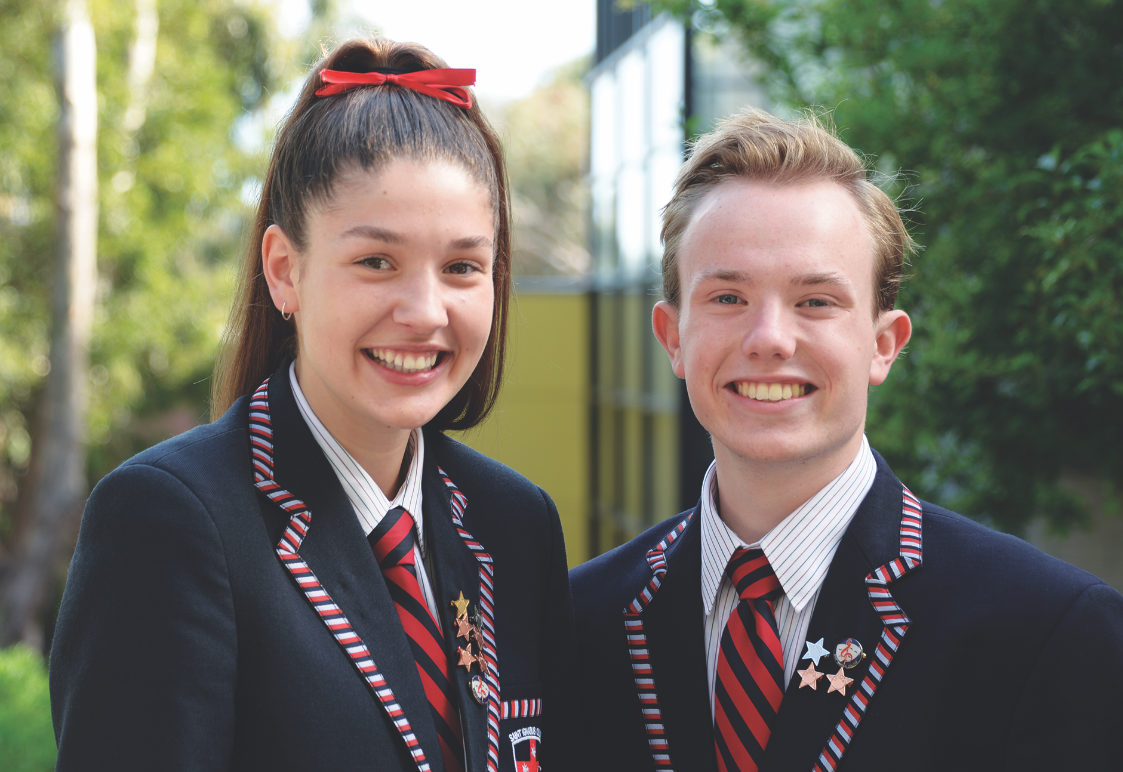
Saint Ignatius College
What is an Ignatian school and
what makes it different?
Heidi Bakker and William Palmer College Captains 2020

Slide 8
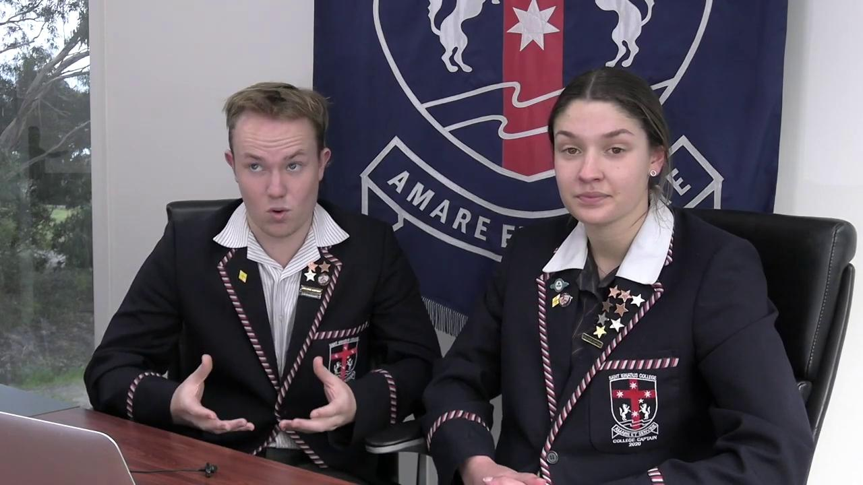

Slide 9
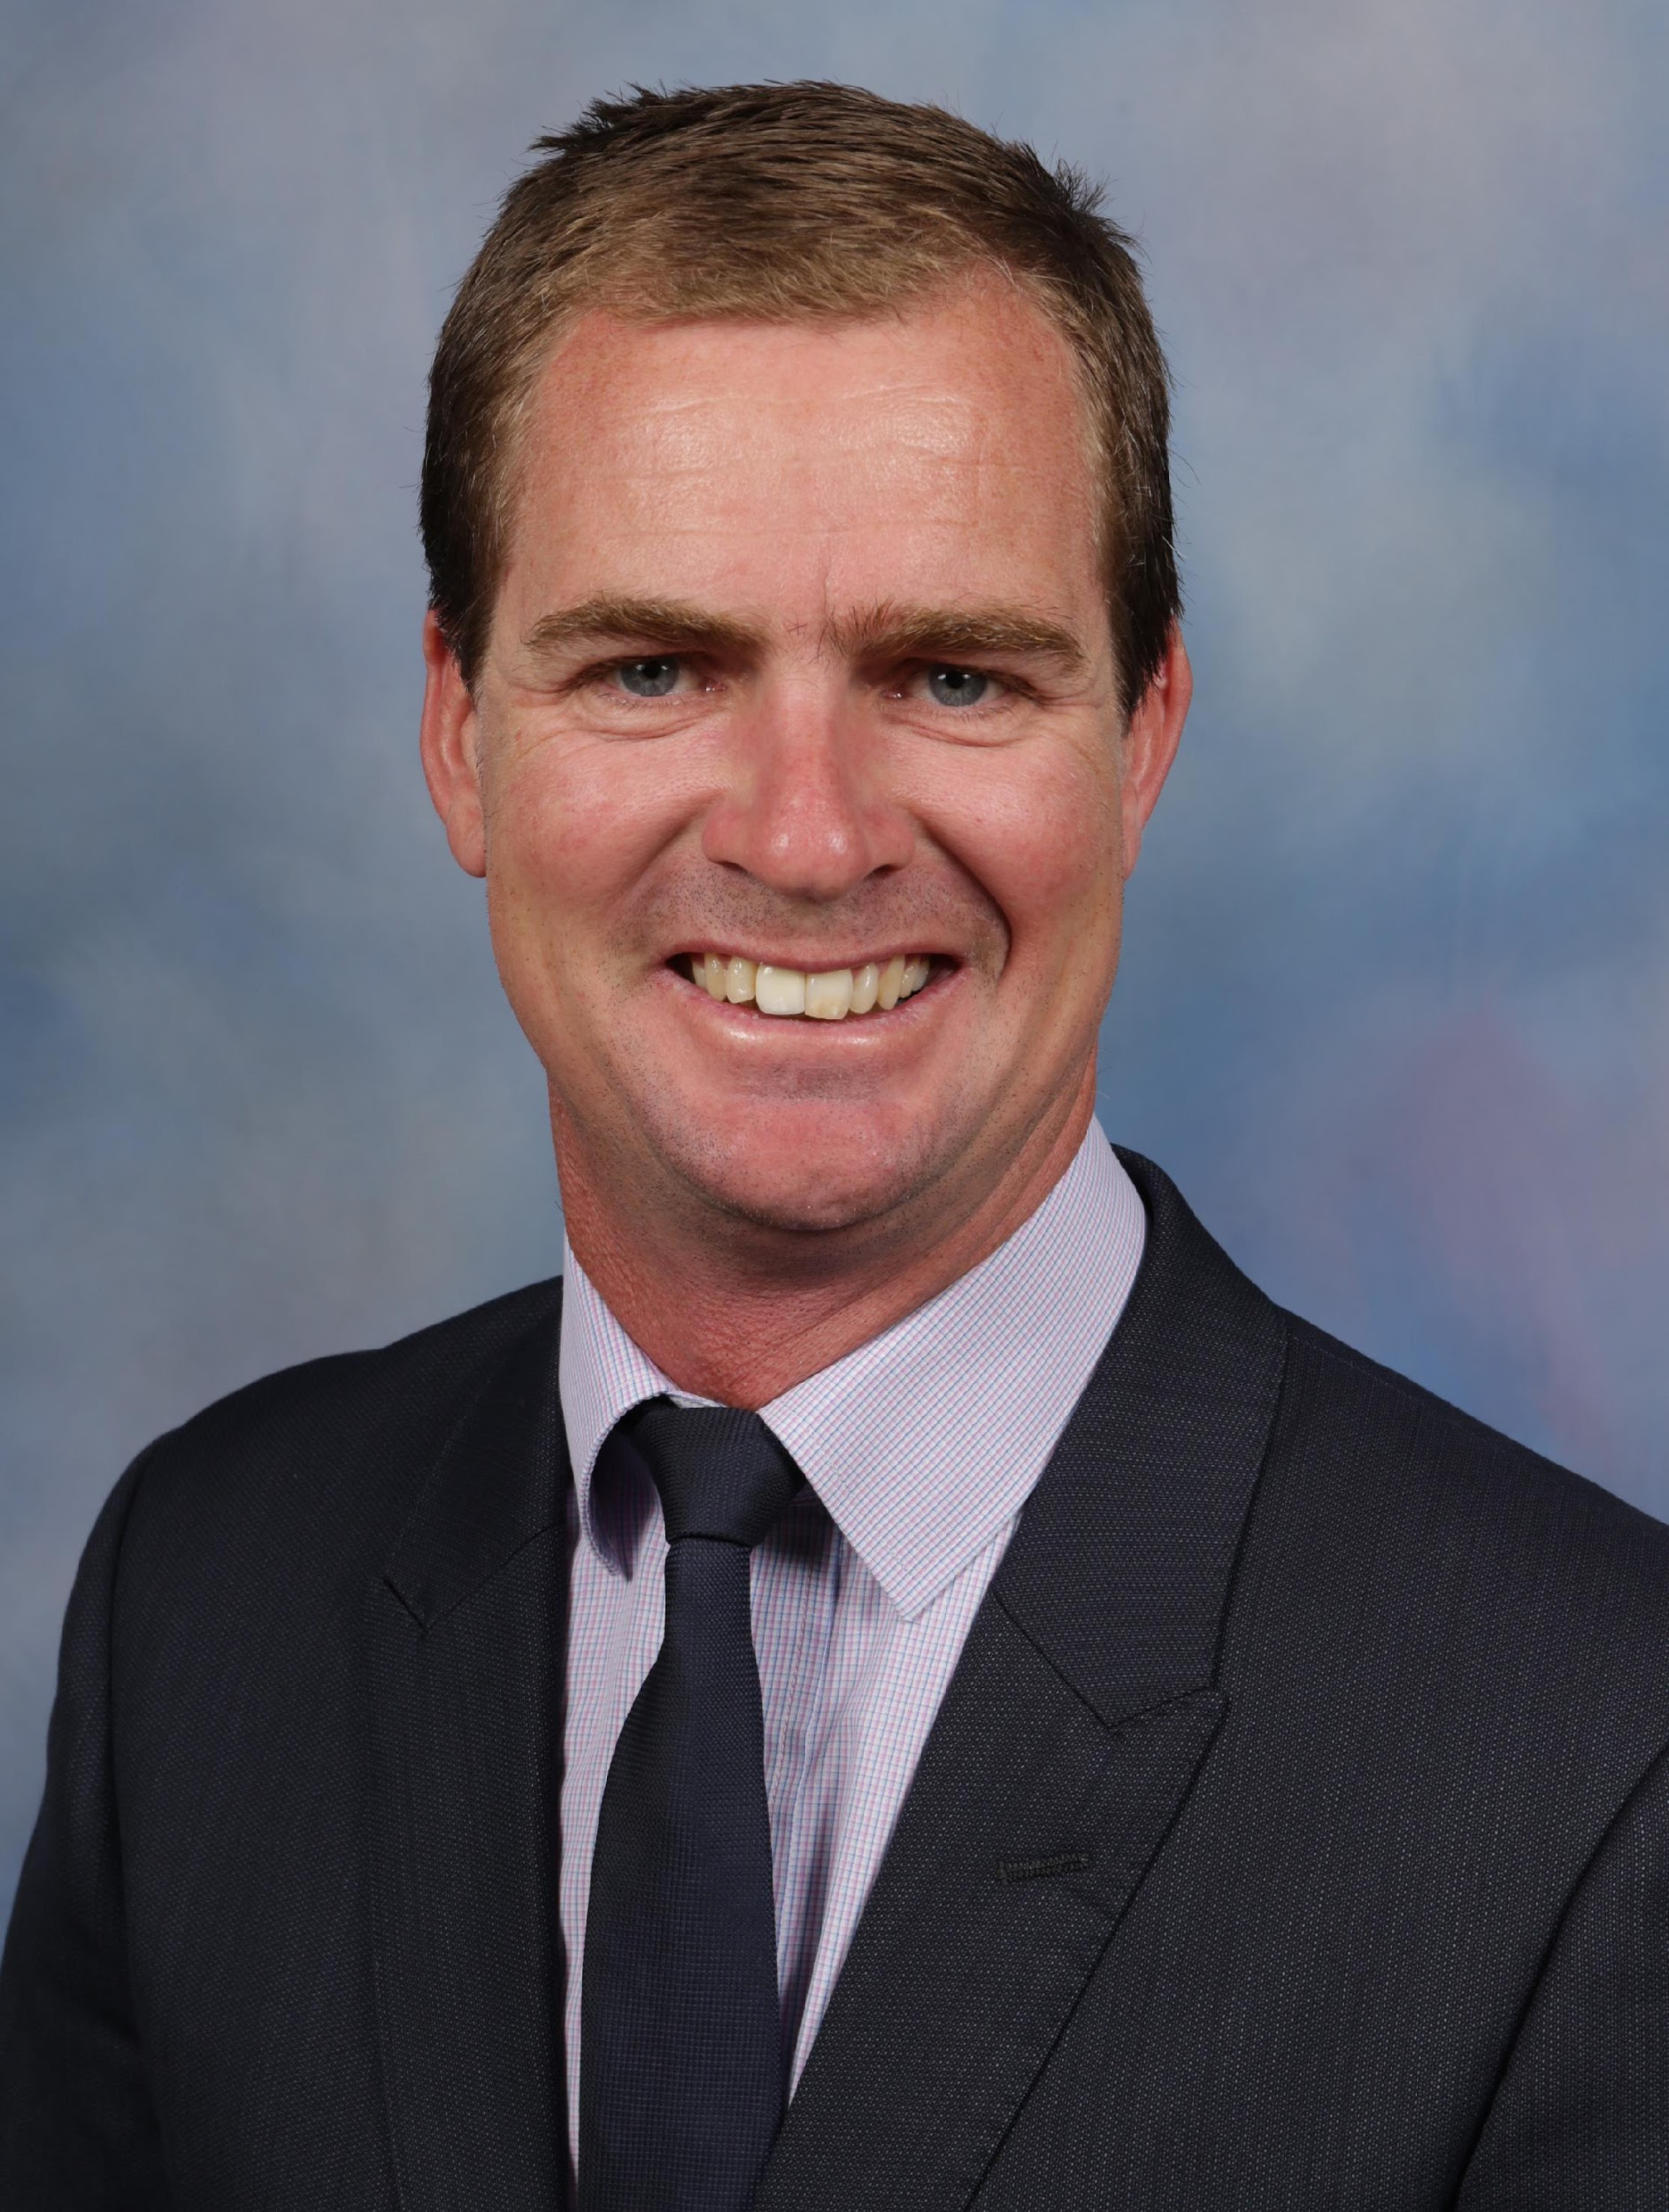
Saint Ignatius College
Expectations of the College
Student Wellbeing
Mr Michael Timms Deputy Principal

Slide 10
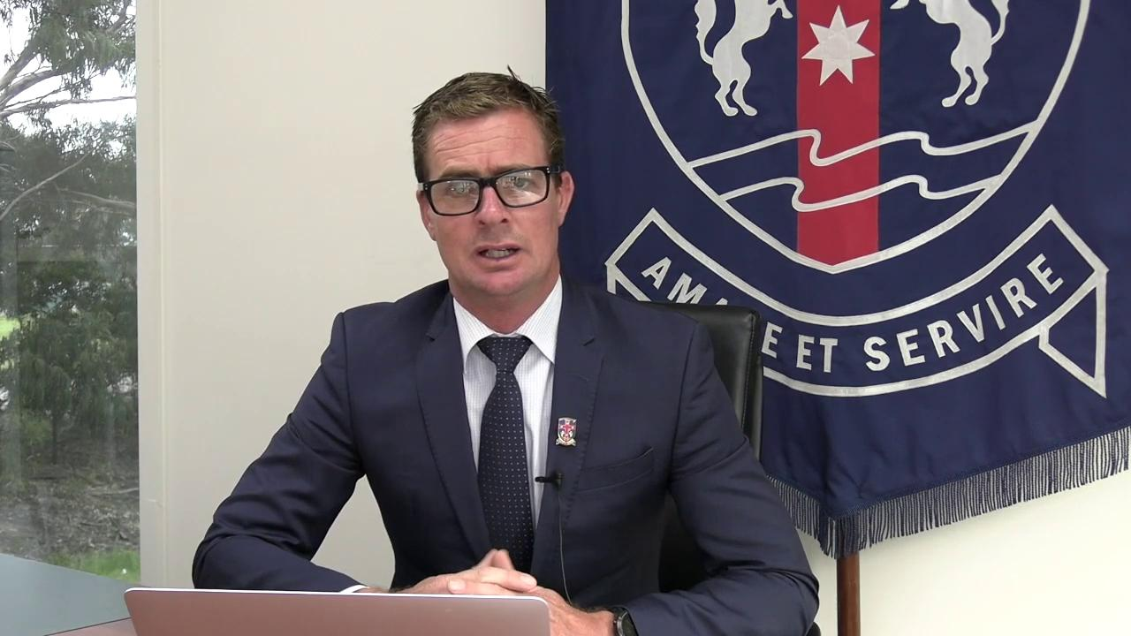

Slide 11
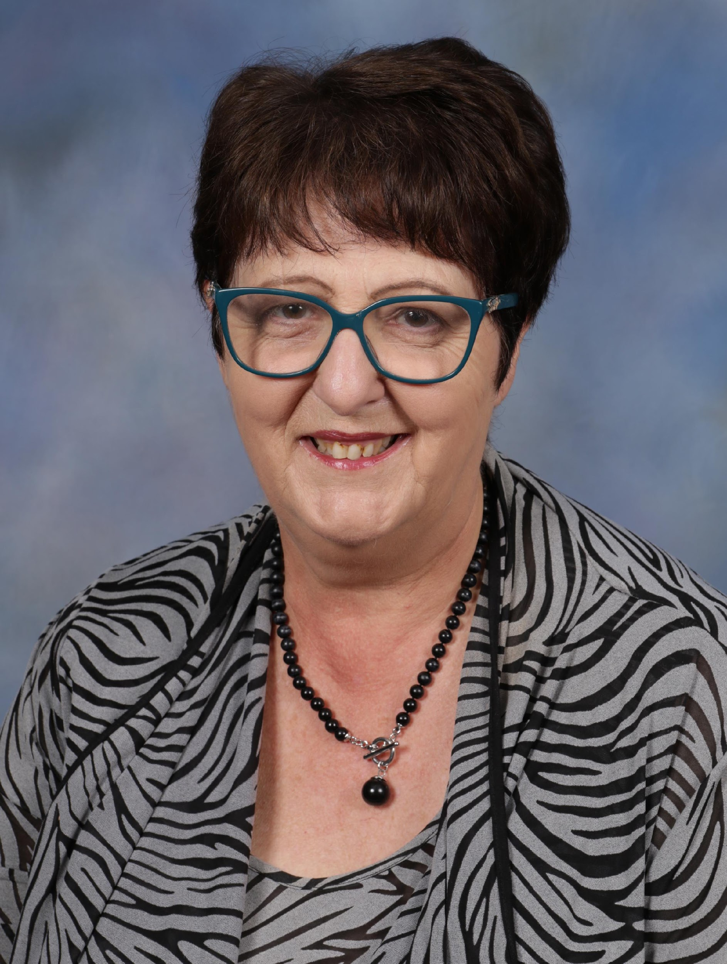
Saint Ignatius College
Curriculum Overview
Mrs Annette Chidzey Deputy Principal

Slide 12
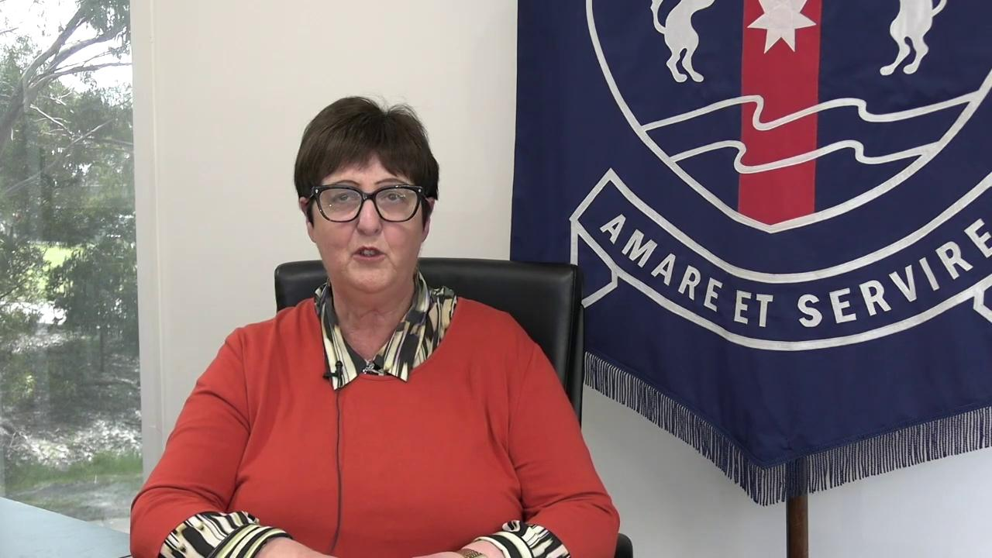

Slide 13
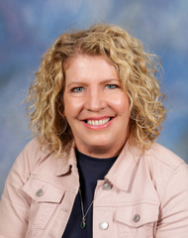
Saint Ignatius College
Introduction
Ms Leonie O’Brien Year 7 Coordinator

Slide 14
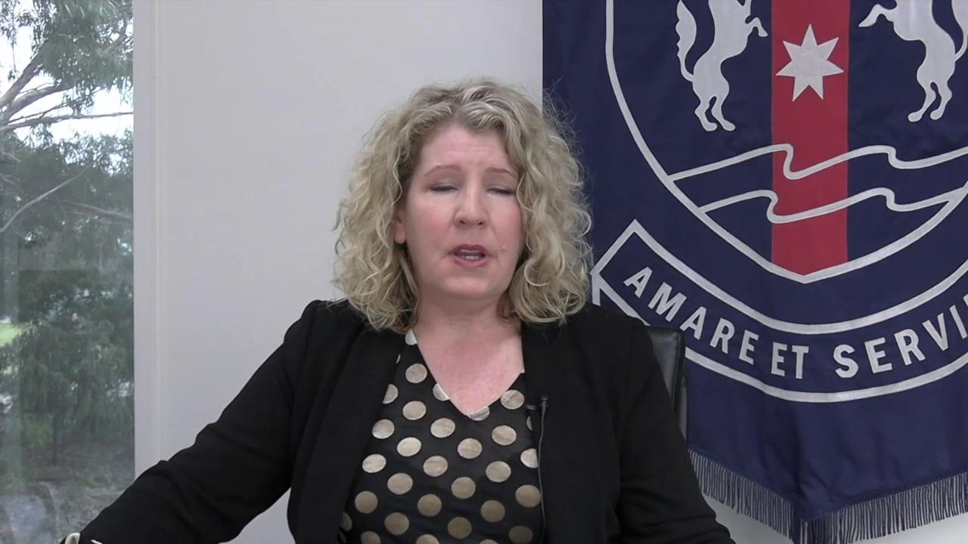

Slide 15
Saint Ignatius College
The role of the
Homeroom Teacher
Alira Smith and Evie Durbidge
Ignatian Leaders Year 7 Borgia

Slide 17
Saint Ignatius College
WIRED Reading
Program / ILC
Georgia Dear and Luke Visser
Ignatian Leaders Year 7 Carroll

Slide 18
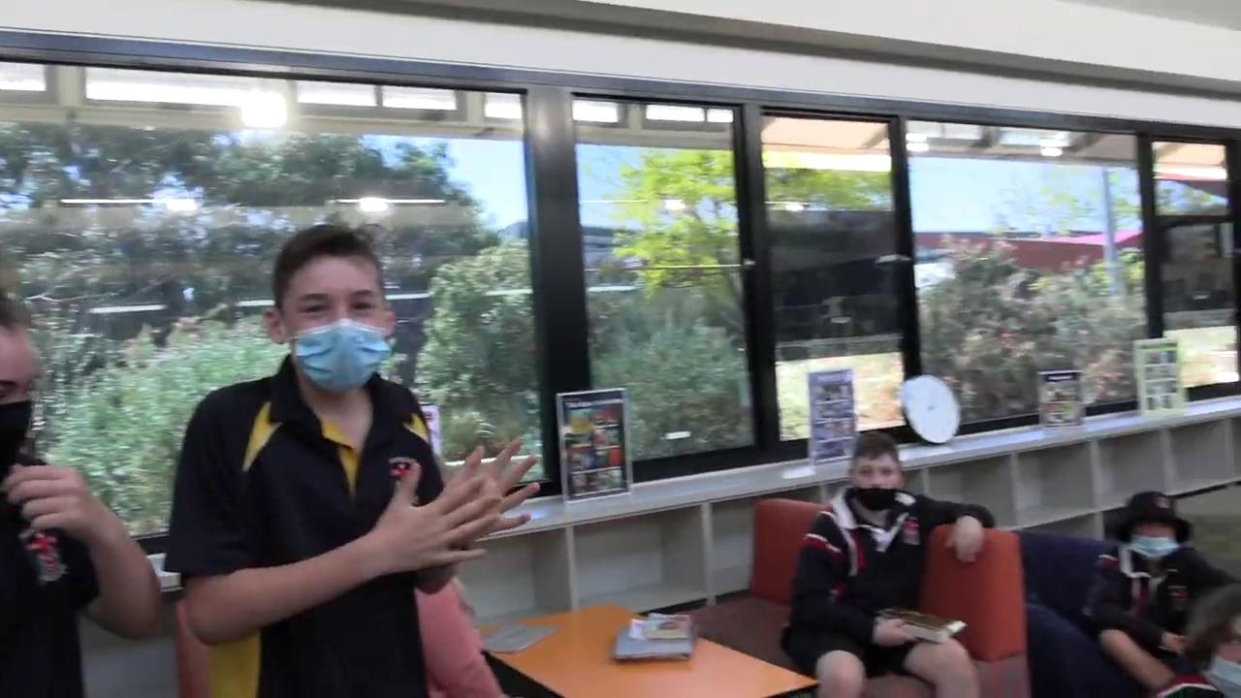

Slide 19
Saint Ignatius College
Buses
Archie Stella and Harriette O’Keefe
Ignatian Leaders Year 7 Ricci

Slide 20
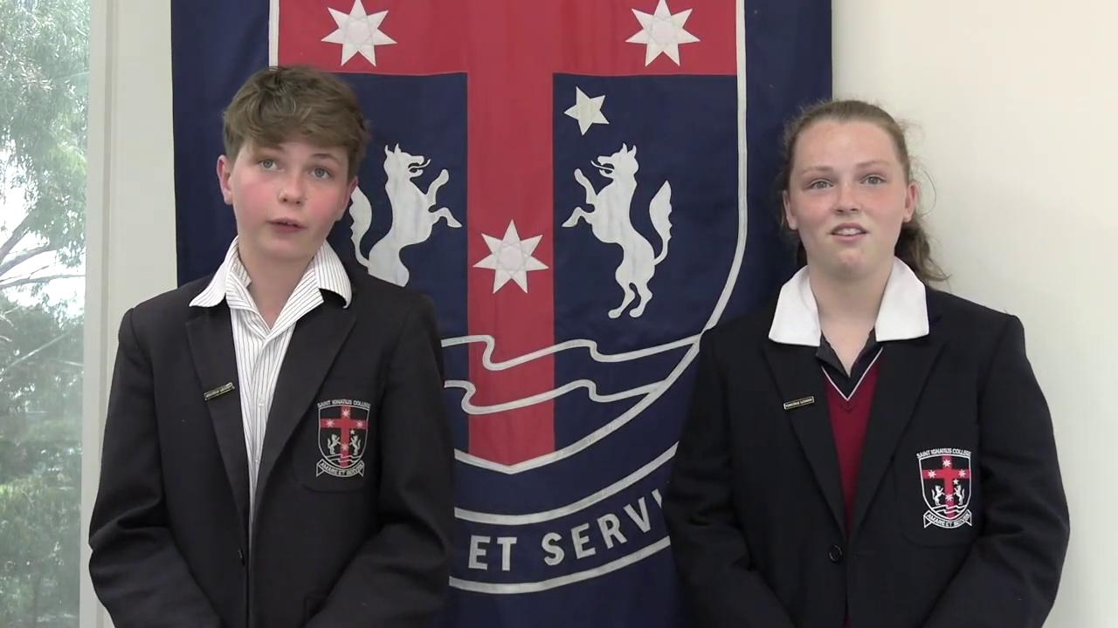

Slide 21
Saint Ignatius College
Parent Communication
Jipsi Jackson and Riley Molloy
Ignatian Leaders Year 7 Lewis

Slide 22
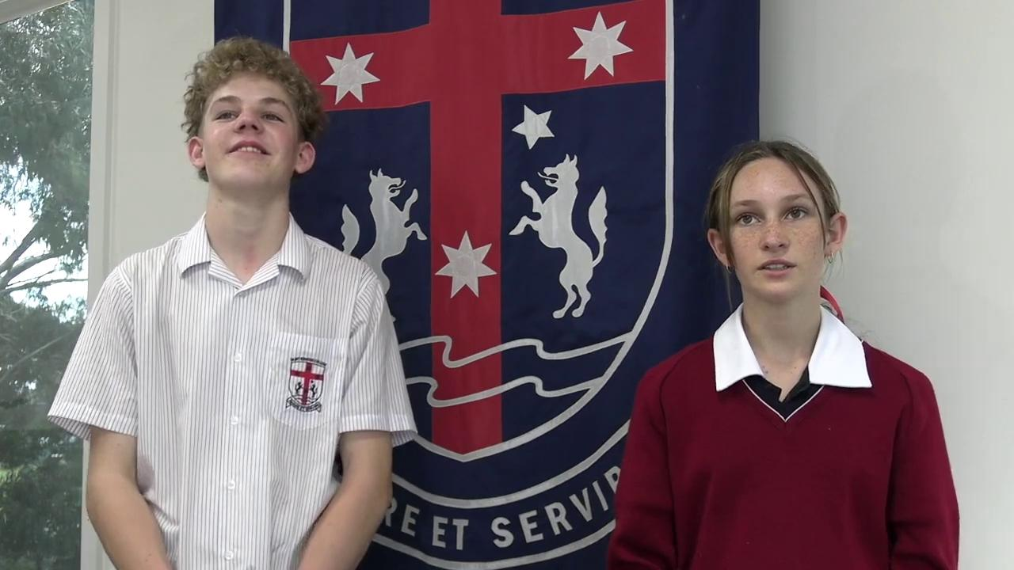

Slide 23
Saint Ignatius College
Academic Uniform
Steph Reynolds and Kai Jones
Ignatian Leaders Year 7 Claver

Slide 24
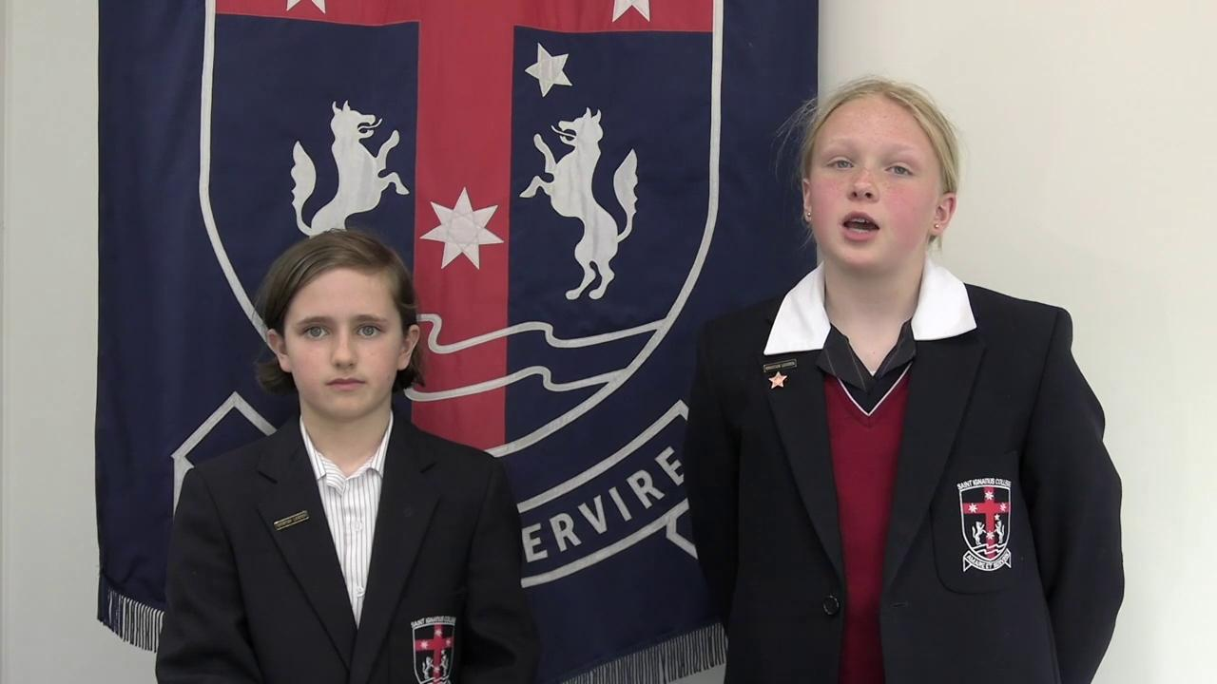

Slide 25
Saint Ignatius College
Sports Uniform
Harry Rawson and Freya Fahey
Ignatian Leaders Year 7 Miki

Slide 26
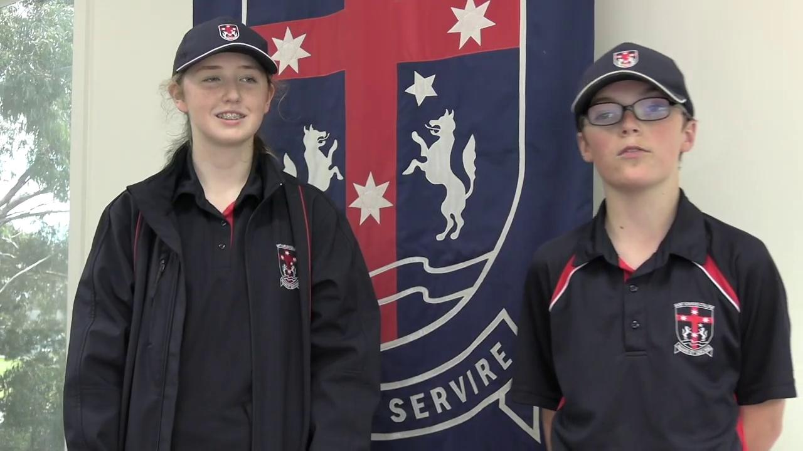

Slide 27
Saint Ignatius College
Core Subjects
Jemma Tingiri and Tucker Kooloos
Ignatian Leaders Year 7 Strada

Slide 28
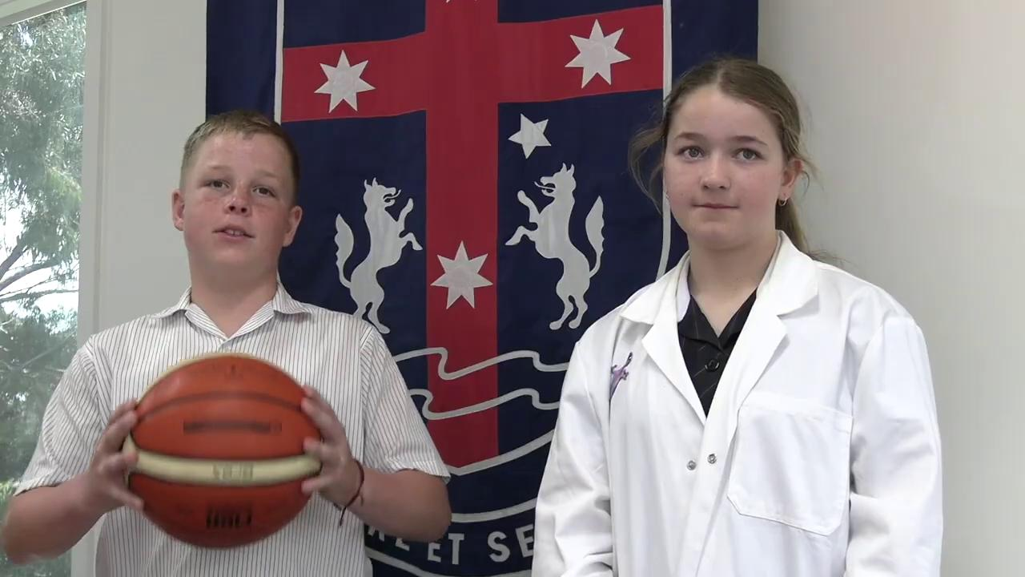

Slide 29
Saint Ignatius College
Elective Subjects
Darcy Kelly and Mikayla Villeda

Slide 30
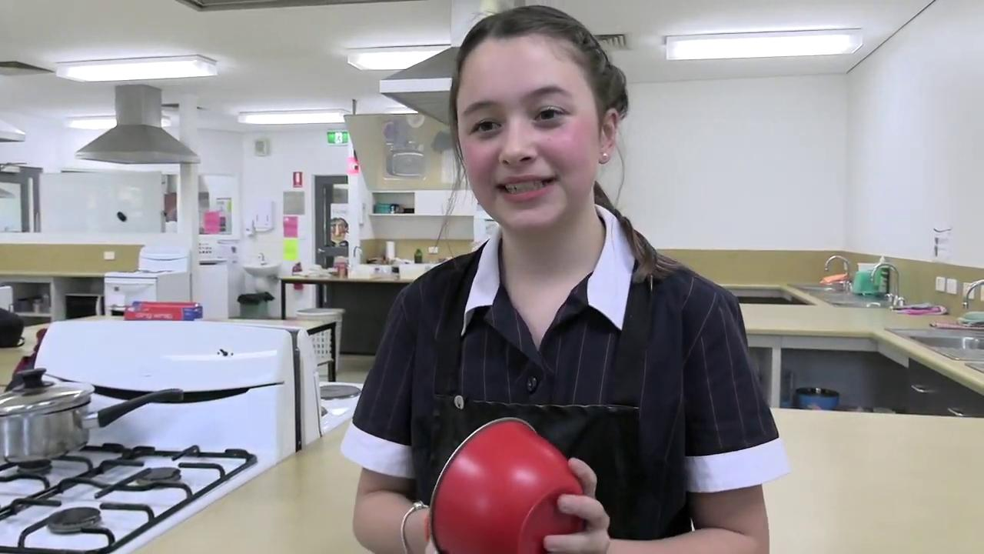

Slide 31
Saint Ignatius College
Music Programs Year 7
Curriculum and Individual Tuition
Dom Sturman and Bel Gee
Ignatian Leaders Year 7 Coudere

Slide 32
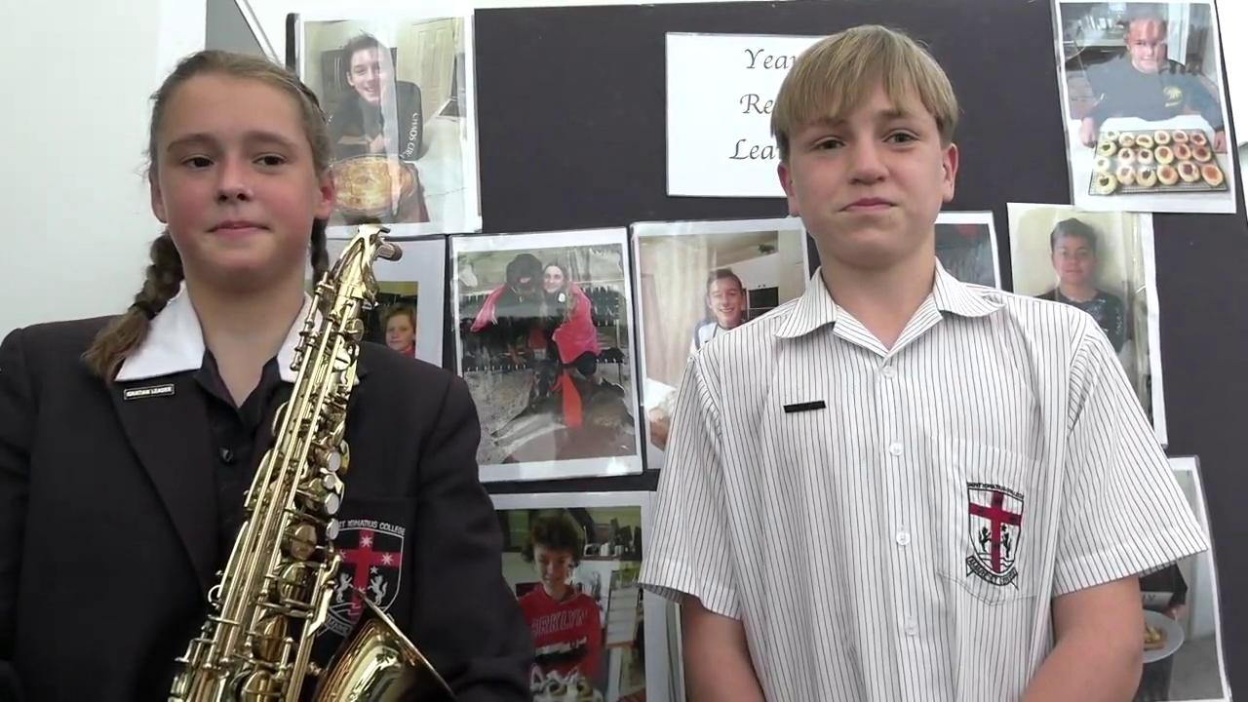

Slide 33
Saint Ignatius College
Gratitude Journaling
What it is and the benefits
Fallon Crabtree and Lachlan Payne
Ignatian Leaders Year 7 Ward

Slide 34
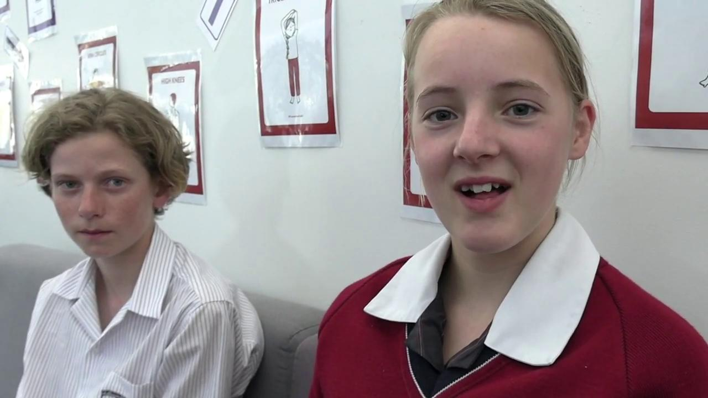

Slide 35
Saint Ignatius College
Sport at Saint Ignatius
Mr Andrew Philp Sports Coordinator

Slide 36
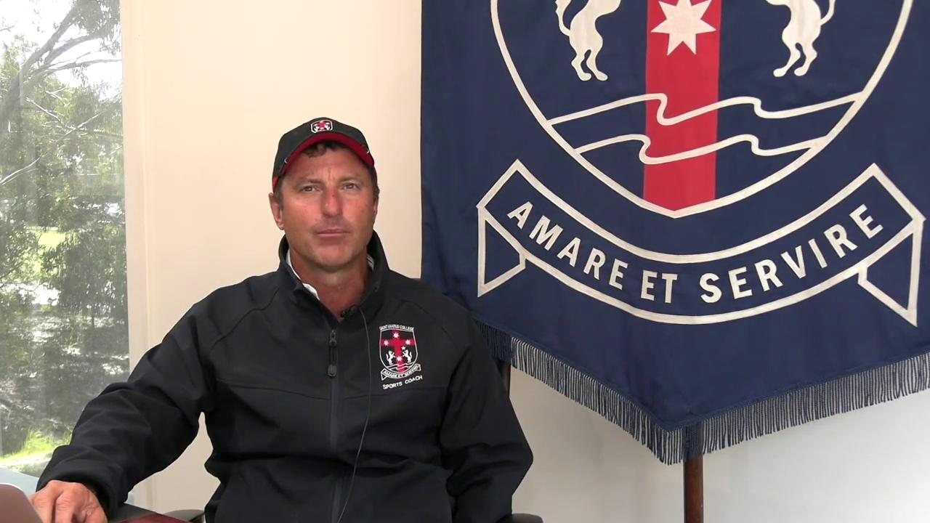

Slide 37
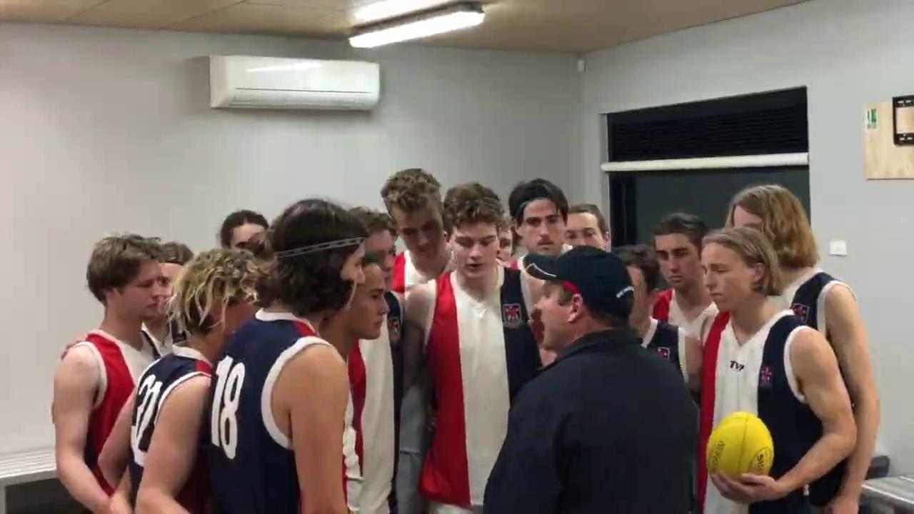

Slide 38
Saint Ignatius College
A Day in the Life
of a Year 7

Slide 40
Saint Ignatius College
Frequently Asked Questions
Luke Visser Year 7 Carroll SRC Rep
Bel Gee Year 7 Coudere SRC Rep
Stephanie Reynolds Year 7 Claver

Slide 41
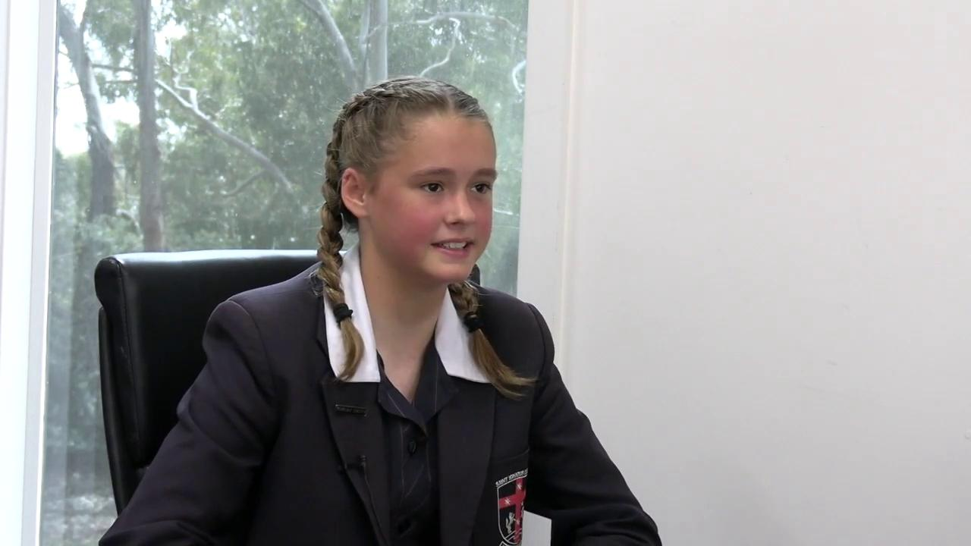

Slide 42
Saint Ignatius College
Our Wellbeing Team
Ms Tenille Thomson Student Wellbeing Coordinator

Slide 43
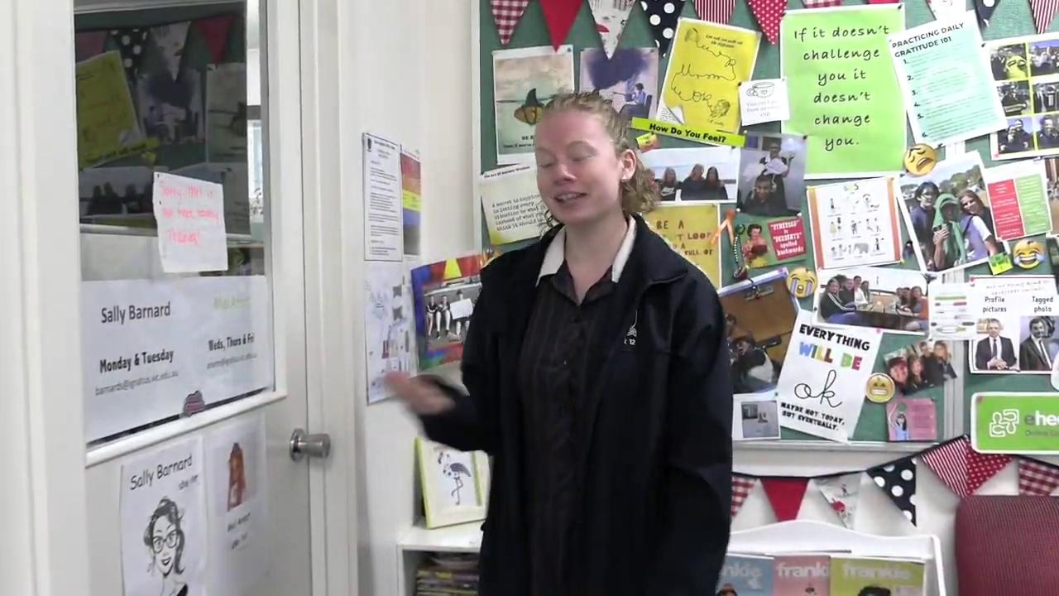

Slide 44
Saint Ignatius College
Parents and Friends’
Association
Ms Sandi Clark

Slide 45
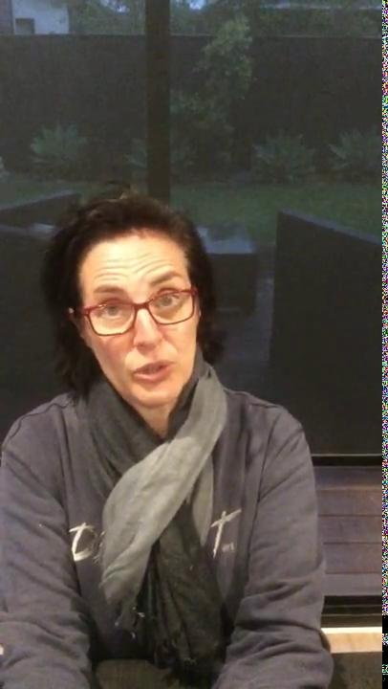

Slide 46
Saint Ignatius College
Year 7 Camp
Anglesea YMCA
May 3rd - 7th 2021

Slide 47
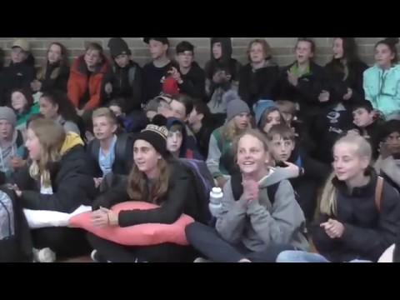

Slide 48
Saint Ignatius College
Interactive School Tour
Use your cursor to move around each room for a 360 deg view.
Click here for tour

Slide 49
Saint Ignatius College
Dates to Remember
Laptop Pick-up January 21st 2021
First Day of School February 1st 2021
Opening Mass February 4th 2021
Year 7 Camp
Camp 1 3rd to 5th May 2021
Camp 2 5th to 7th May 2021

Slide 50
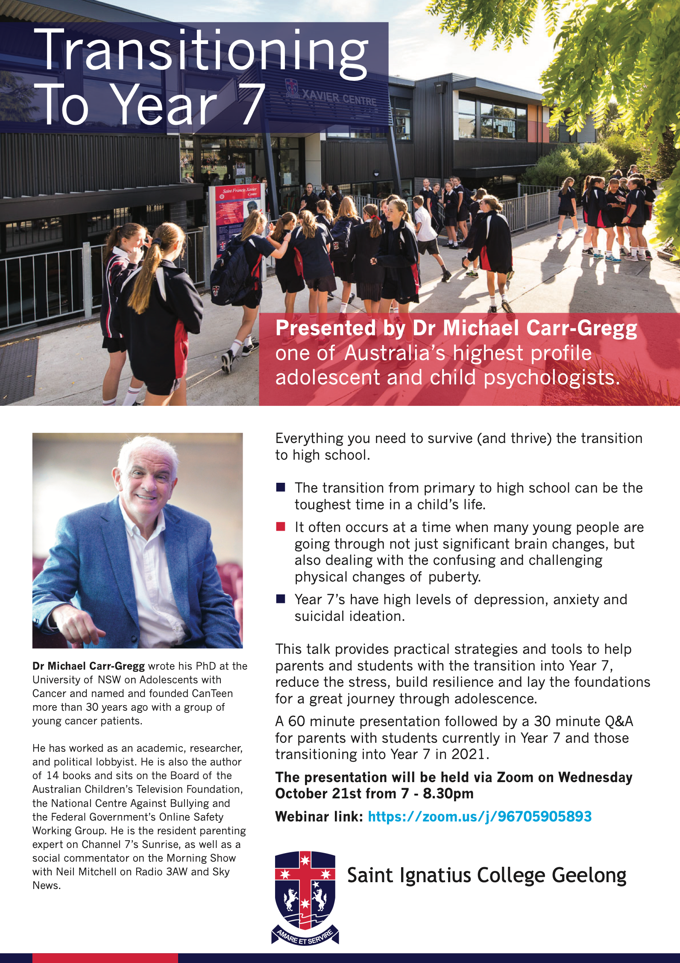

Slide 51
Thank you for watching.
See you at the webinar Wednesday 21st October 2020 at 6.50pm

